Slide 1
CPE 404
Computer Hardware Design
Dr Osama Hosameldeen
Spring 2021
Lecture 7
Sequential Circuits – Analysis and Design

Slide 2
Topics
Sequential Circuit Analysis
Sequential Circuit Design
  Designing with D Flip-Flops
  Designing with JK Flip-Flops
  Designing with T Flip-Flops
Examples
Notes:
School of Engineering

Slide 3
Analysis

Slide 4
Analysis of Sequential Circuits
Earlier we learned how to analyze combinational circuits
We will extend analysis to synchronous sequential
We’ll use
  State tables and
  State diagrams

Slide 5
Analysis vs. Design
The analysis of sequential circuits starts from a circuit diagram and culminates in a state table or state diagram.
The design of a sequential circuit starts from a set of specifications and we should obtain the
  State diagram,
  State table, and finally
  Circuit diagram.

Slide 6
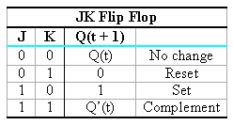


Characteristic Tables
Characteristic tables will be used to analyze the behavior of sequential circuits.
Recall Characteristic Tables: Given the Input Determine the next state

Slide 7
Analysis of Sequential Circuits
The behavior of a sequential circuit is determined from:
  Inputs,
  Outputs,
  Present state of the circuit.
The analysis of a sequential circuit consists of:
  Deriving the Input Equations to the Flip Flops.
  Obtaining a STATE TABLE
  Obtaining a suitable description that demonstrates the time sequence of inputs, outputs and states (STATE DIAGRAM).

Slide 8
Analysis: Example

Slide 9
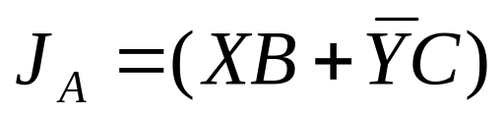
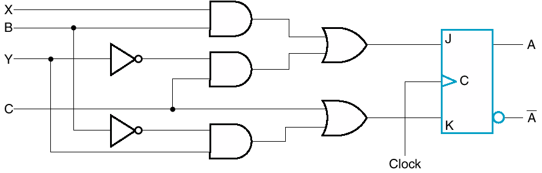
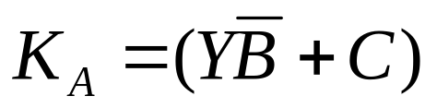
Step #1: Derive Input Equations
Can describe inputs to FF with logic equations
X.B
Y’.C
Y.B’
This circuit has 1 Flip Flop, therefore we can have two states

Slide 10
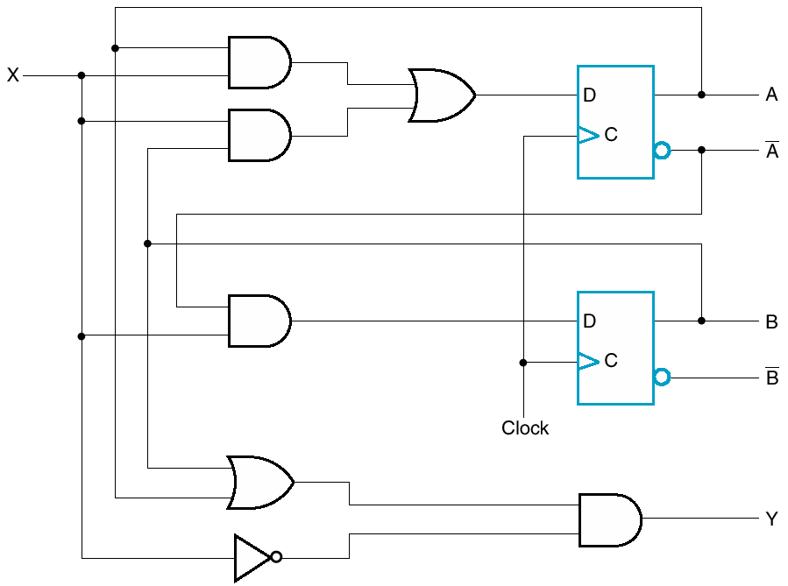
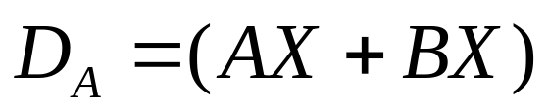
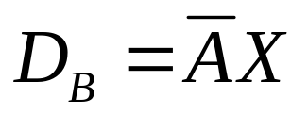
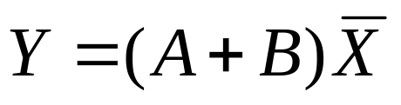
Another Example
This circuit has 2 Flip Flops, therefore we can have four states
A.X
B.X

Slide 11
Analysis: Input Equations

Slide 12
Input Equations
The input equations
  Imply the type of flip-flop from the letter symbols,
  Fully specify the combinational circuit that drives the flip-flops.

Slide 13
Time is Implied
Note that previous circuits used the
  Present state (A, B, ..) and inputs to determine next state
  Present state and inputs to determine output
Synchronous circuit (clock driven)
When are transitions?

Slide 14
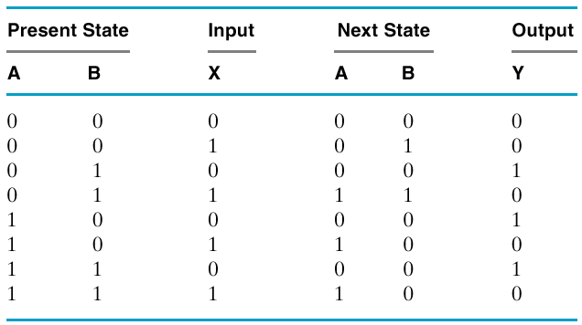
Step #2: State Table
Similar to truth table with state added
A sequential circuit with `m’ FFs and `n’ inputs needs 2^{m+n} rows in state table.
Next State and output are determined using? (input equations)
Left Hand Side
Right Hand Side

Slide 15
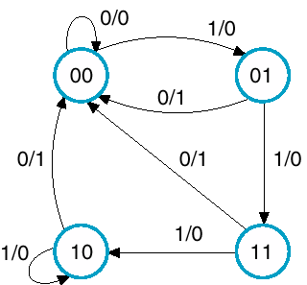
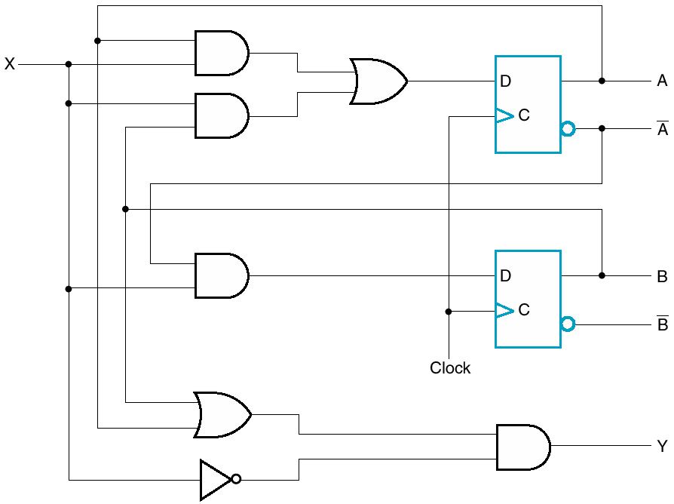
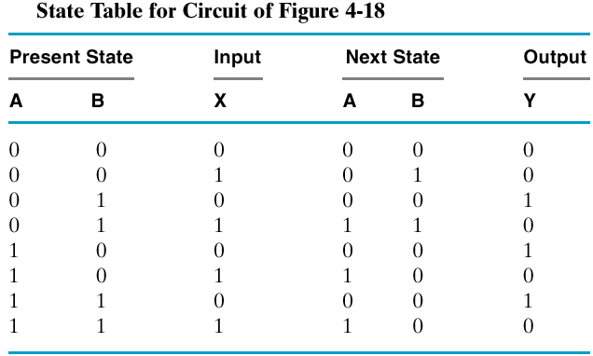
Step#3: State Diagram “Mealy Model”
Input
Output
An alternative representation to State Table
Input
Output
11
0/0
00
1/0
01
1/0
Input/Output
Mealy model – outputs depend on inputs & states

Slide 16
Sequential Circuits: Types

Slide 17

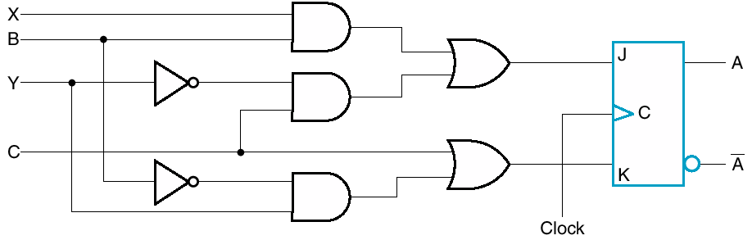
Sequential Circuit Types
Moore model – outputs depend on states only.
Mealy model – outputs depend on inputs & states

Slide 18
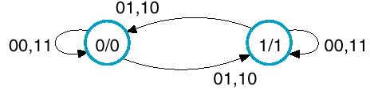
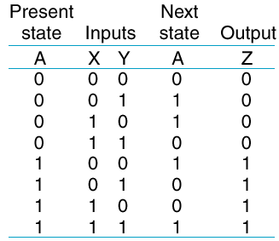
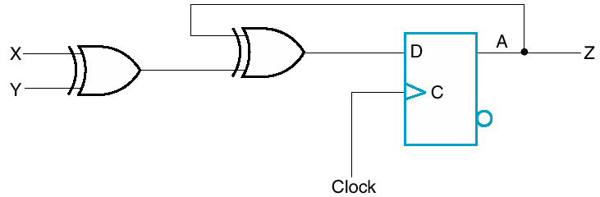
State Diagram: Moore Model
xy,xy
Inputs
Moore model – outputs depend on states only.
00,11
0/0
1/1
00,11
State/Output
01,10
Inputs
State/Output

Slide 19
Moore vs. Mealy Machine
Moore Machine:
  Easy to understand and easy to code.
  Might requires more states (thus more hardware).
Mealy Machine:
  More complex since outputs are a function of both the state and input.
  Requires less states in most cases, therefore less components.
Choice of a model depends on the application and personal preference.
You can transform a Mealy Machine to a Moore Machine and vice versa.

Slide 20
State Table

Slide 21
State Table vs. Diagram
Provides same information
  Table is perhaps easier to fill in from description
  Diagram is easier for understanding and writing code
Analysis for sequential circuits that employs D flip flops is easy. Why?
  Because the next state values are obtained directly from the input equations.

Slide 22
Analysis: JK Flipflops

Slide 23
Analysis with JK Flip Flops
For circuits with other types of flip flops such as (J-K, T FF) the next state values are obtained by following the two step procedure:
  Obtain the binary values of each flip-flop input equation in terms of the present state and input variables.
  Use corresponding flip-flop characteristic table to determine the next state.

Slide 24
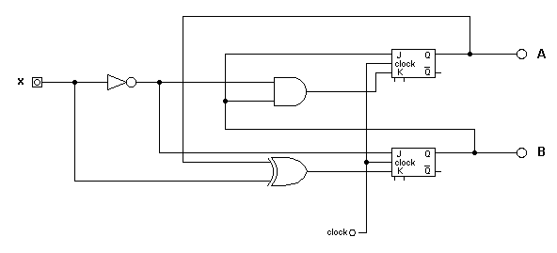
Analysis with JK Flip Flops
First, Obtain the input equations for each flip flop
This circuit has 2 Flip Flops, therefore we can have four states
J_{A} = B
J_{B} = x’
K_{A} = Bx’
K_{B} = A’x + Ax’ = A ⊕ x
Next: Build the state table. How many entries?

Slide 25
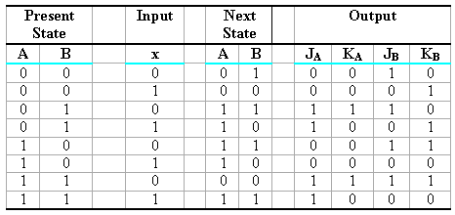
JK Analysis: State Table
Use the Input equations to determine the FF inputs.
Use the FF inputs and Table to determine the next state.
Flip Flop Inputs
JK Characteristic Table
J_{A} = B
K_{A} = Bx’
J_{B} = x’
K_{B} = A’x + Ax’ = A ⊕ x

Slide 26
JK Analysis: State Table
Flip Flop Inputs
J_{A} = B
J_{B} = x’
K_{A} = Bx’
K_{B} = A’x + Ax’ = A ⊕ x

Slide 27
JK Analysis: State Diagram
1
1
0
00
11
0
0
0
01
10
1
1

Slide 28
Design

Slide 29
Analysis vs. Design
The analysis of sequential circuits starts from a circuit diagram and culminates in a state table or state diagram.
The design of a sequential circuit starts from a set of specifications and we should obtain the state diagram and finally the circuit (logic) diagram.

Slide 30
Design Procedure
Design starts from a specification and results in a logic diagram or a list of Boolean functions.
The steps to be followed are:
  Derive a state diagram
    Assign binary values to the states
  Choose the type of flip flops to be used
  Obtain the binary coded state table
    Use Excitation Tables to derive state table
  Derive the simplified flip flop input equations and output equations
  Draw the logic diagram

Slide 31
Sequential Circuit Design
Remember that a synchronous sequential circuit is made up of flip flops and combinational gates.
Part of the design is to choose the flip-flop type and combinational circuit structure which, together with the flip-flops produce a circuit that fulfills the stated specification.
How many FLIP FLOPS?
  The number of flip-flops is determined from the number of states in the circuit
  n flip-flops can represent up to 2^{n} binary states.
  Examples:
    2 states requires a single Flip Flop
    4 states requires two flip flops
    8 states requires three flip flops
    7 states requires again three flip flops …

Slide 32
Design: with D Flip Flops

Slide 33
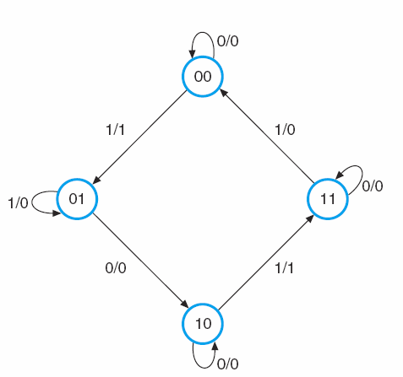
Designing with D Flip-Flops
Four States?
2 flipflops
Design a clocked sequential circuit that operates according to the state diagram.
Use D Flip Flops
Inputs?
Outputs?

Slide 34
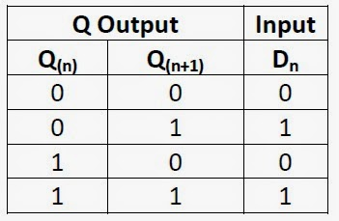
Synthesizing Using D Flip Flops
The next step is to create a state table and then select two D flip flops to represent the four states, labeling their outputs as A and B.
There is one input, x, and one output, y, representing the input sequence and the output value respectively.
Remember that the Excitation Table (characteristic equation) of the D flip flop is
  Q(t + 1) = D_{Q}
  This means that the next-state values in the state table specify the D input condition for the flip flop.

Slide 35
Designing with D Flip-Flops
Determine the logic that drives the flip flop
D_{A} ?
D_{A}
X
D_{B} ?
D_{B}
Y ?

Slide 36
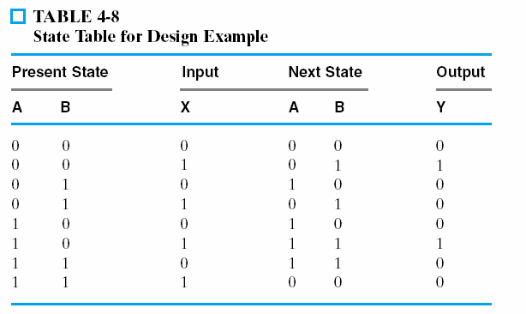
Designing with D Flip-Flops
The left hand side of the state table is derived by identifying the number of flipflops used and number of inputs (two flip flops, 1 input)
The right hand side of the state table should list “Next State” and output
The state table can be completed by inspecting the state diagram.
  Start from state “00” and check the input and output.
  If present state “00” and input X is “0” then the next state is “00” and output is “0”
  If present state “00” and input X is “1” then the next state is “01” and output is “1”
Next State
Output
A
B
Y
0
0
0
0
1
1

Slide 37
Designing with D Flip-Flops
Input equations can be obtained directly from the table using minterms:
  A(t + 1) = D_{A}(A, B, x) = ∑m(2,4,5,6)
  B(t + 1) = D_{B}(A, B, x) = ∑m(1,3,5,6)
  Y =
  ∑m(1,5)
State Table
State Diagram

Slide 38
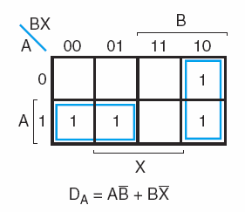
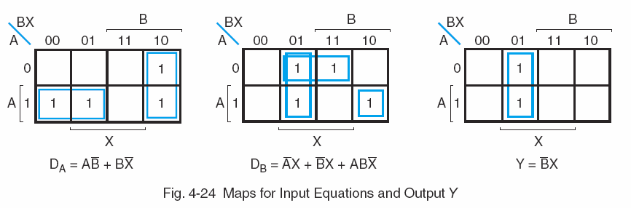
Designing with D Flip-Flops
However, we have to minimize (k-maps) the expression in a similar way used for combinational logic design!

Slide 39
Designing with D Flip-Flops

Slide 40
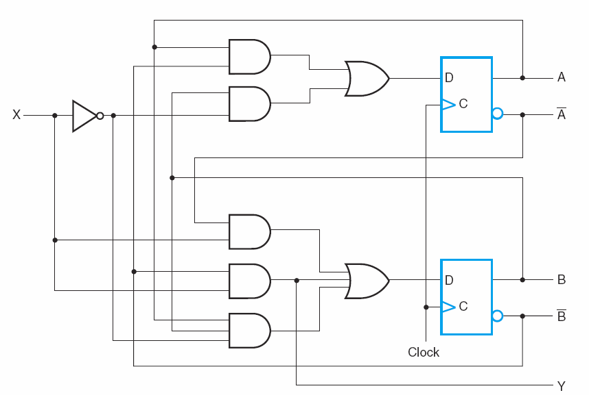
Designing with D Flip-Flops
D_{A} = AB’ + BX’
D_{B}= A’X + B’X+ ABX’
Y = B’X

Slide 41
Design: Example #1

Slide 42
A Sequence Detector
Design a circuit that detects a sequence of three ones. Use a Moore Machine (i.e. outputs a “1” if it detects the occurrence of “111” else outputs a “0”).
Create the state diagram
output
input
0
0
00/0
1
01/0
Input
Circuit Detects
`111’ at input
Output
0
1
0
000011101
11/1
10/0
1
1

Slide 43
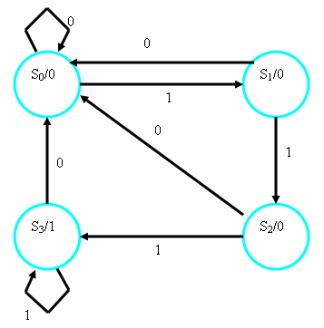
A Sequence Detector
Design a circuit that detects a sequence of three ones. Use a Moore Machine.
From State diagram obtain the state table
Input
Circuit Detects
`111’ at input
Output
Moore Machine

Slide 44
Synthesizing Using D Flip Flops
The next step is to create a state table and then select two D flip flops to represent the four states, labeling their outputs as A and B.
There is one input, x, and one output, y, representing the input sequence and the output value respectively.
The output y is `1’ only when we detect the input sequence of `111’

Slide 45
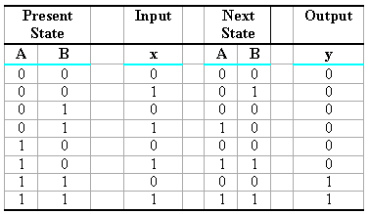
State Table for Sequence Detector
Input equations can be obtained directly from the table using minterms:
  A(t + 1) = D_{A}(A, B, x) = ∑m(3, 5, 7)
  B(t + 1) = DB(A, B, x) = ∑m(1, 5, 7)
  y(A, B, x) = ∑m(6, 7)

Slide 46
Boolean Minimization
K-Maps can be used to minimize the input equations, resulting in
  D_{A} = Ax + Bx
  D_{B} = Ax + B’x
  Y = AB

Slide 47
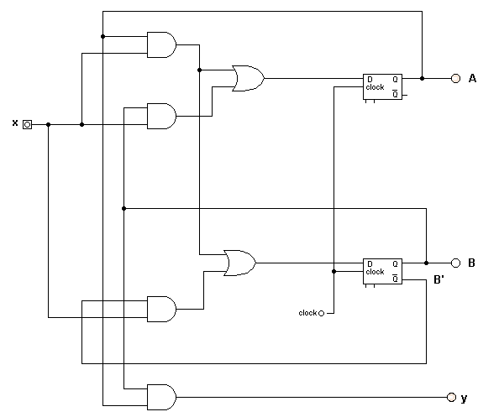
Logic Diagram of Sequence Detector
  D_{A} = Ax + Bx
  D_{B} = Ax + B’x
  Y = AB

Slide 48
Design with JK/T Flipflops

Slide 49
Sequential Circuits with different Flip Flops (JK, T)
The design of sequential circuits other than D type flip flops is complicated by the fact that input equations must be derived indirectly from the state table.
  It is necessary to derive a functional relationship between the state table and the input equations.

Slide 50
Excitation Table
During the design, we usually know the transition from present to next state, but we need to find the flip flop input conditions that will cause the required transition.
  We need a table that lists the required inputs for a given change of state, called an excitation table.

Slide 51
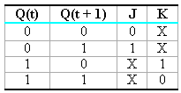
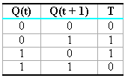
Excitation Tables
Given Inputs Determine Q(t+1)
Given Q(t), Q(t+1) determine Inputs
Characteristic Table
Excitation Table
Characteristic Table
Excitation Table

Slide 52
Synthesis Using JK Flip Flops
Synthesis of circuits with JK flip flops is the same as with D flip flops
  Except that the input equations must be evaluated from the present-state to the next-state transition derived from the excitation table.

Slide 53
Design: JK-FF Example

Slide 54
Example: JK Synthesis
Example: No output
4 states requires 2 FF
0
Step #1: Obtain State Table
Input
00
1
1
1
01
11
0
0
1
10
0

Slide 55
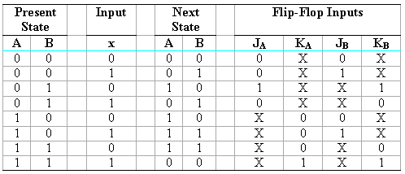
JK Synthesis: State Table
Derive the Flip Flop Inputs
Present
State
Next
State
0
0
0
1
0
0
0
1
JK Flip Flop Excitation Table

Slide 56
Cont .. Example JK Synthesis
Step #2: Derive the Boolean Equation of J_{A}, K_{A}, J_{B}, K_{B}
  J_{A} = ∑m(2)
  J_{B} = ∑m(1,5)
  K_{A} = ∑m(7)
  K_{B} = ∑m(2,7)
But we can use K-Maps to simplify the Boolean Equations: Lots of X

Slide 57
Cont .. Example JK Synthesis
Bx
00
01
11
10
A
0
0
0
0
1
J_{A} = BX’
1
X
X
X
X

Slide 58
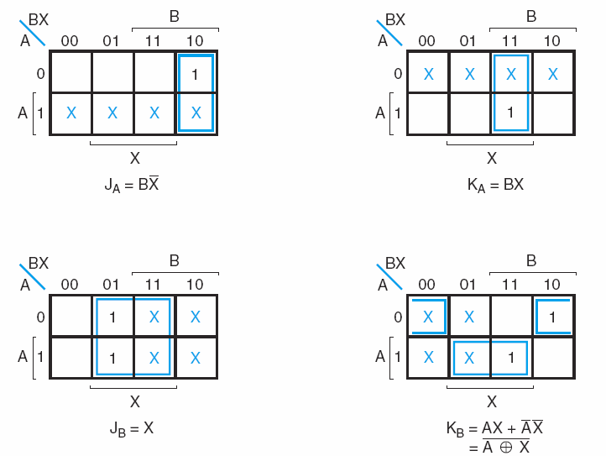
Cont .. Example JK Synthesis

Slide 59
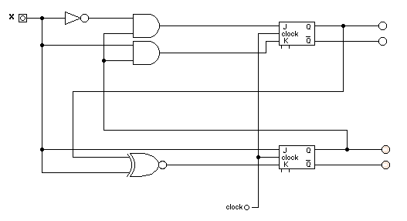
Cont .. JK Synthesis Logic
Diagram
J_{A} = BX’
K_{A} = BX
J_{B} = X
K_{B} = AX + A’X’

Slide 60
Design: T-FF Example

Slide 61
Synthesis Using T Flip Flops
Synthesis of circuits with T flip flops is similar to JK flip flops … except that the input equations must be evaluated from the present-state to the next-state transition derived from the T Excitation table.

Slide 62
Synthesis Using T Flip Flops
Design a counter that counts from “000” to “111” and then back to “000” again.
  Constraint: Use T Flip-Flops

Slide 63
A Counter using T Flip Flops
000
001
010
011
111
110
101
100
Notice the only input is the clock!

Slide 64
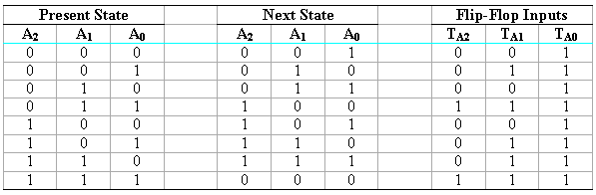
Example: T Flip Flop Synthesis
0
T Flip Flop Excitation Table

Slide 65
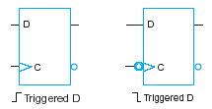

Cont .. T Flip Flops
By using K-maps we can minimize the flip flop input equations.
T
A₂
T
A₁
1
T
A₀

Slide 66
Design: Terminology

Slide 67
One Dimensional Tables

Slide 68
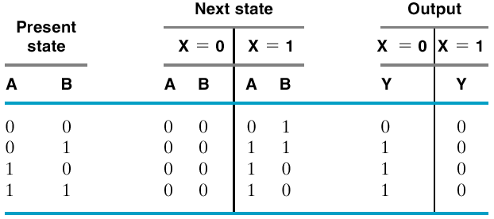
Two Dimensional Tables
Same thing, different layout

Slide 69
Lecture End

